Slide 1
👀Encryption Overview
Huiyue Bai
Situ Feng

Slide 2
Table of Contents 📕
Introduction to Encryption 👀
History of Encryption 📑
How does Encryption work 😲
Examples of Encryption 🐾
Motivations behind Homomorphic Encryption 💪
How does Homomorphic Encryption work 📐
Future directions 🔎
Notes:
Maybe some animations

Slide 3
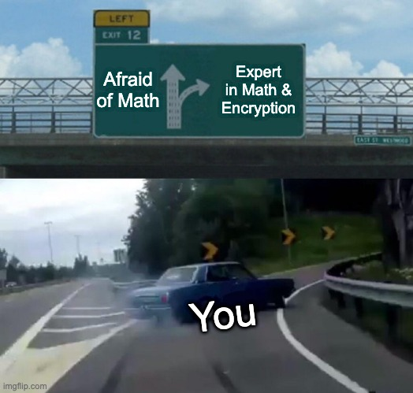
Notes:
A little more time

Slide 4

What is Encryption❓
The process of encoding information
PlainText + Encryption = CipherText
CipherText + Decryption = PlainText

Slide 5
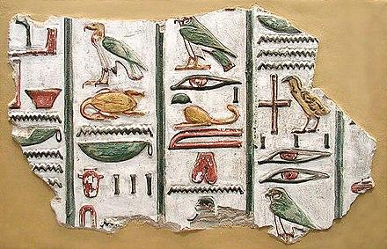
When did encryption become a thing❓
1900 B.C. -> 700 B.C. -> The Middle Ages -> 1976
1900 B.C. an Egyptian scribe used nonstandard hieroglyphs to hide the meaning of an inscription
Notes:
Well, back to those days, not everyone could read. Simply writing things down is already a good way of encrypting information

Slide 6
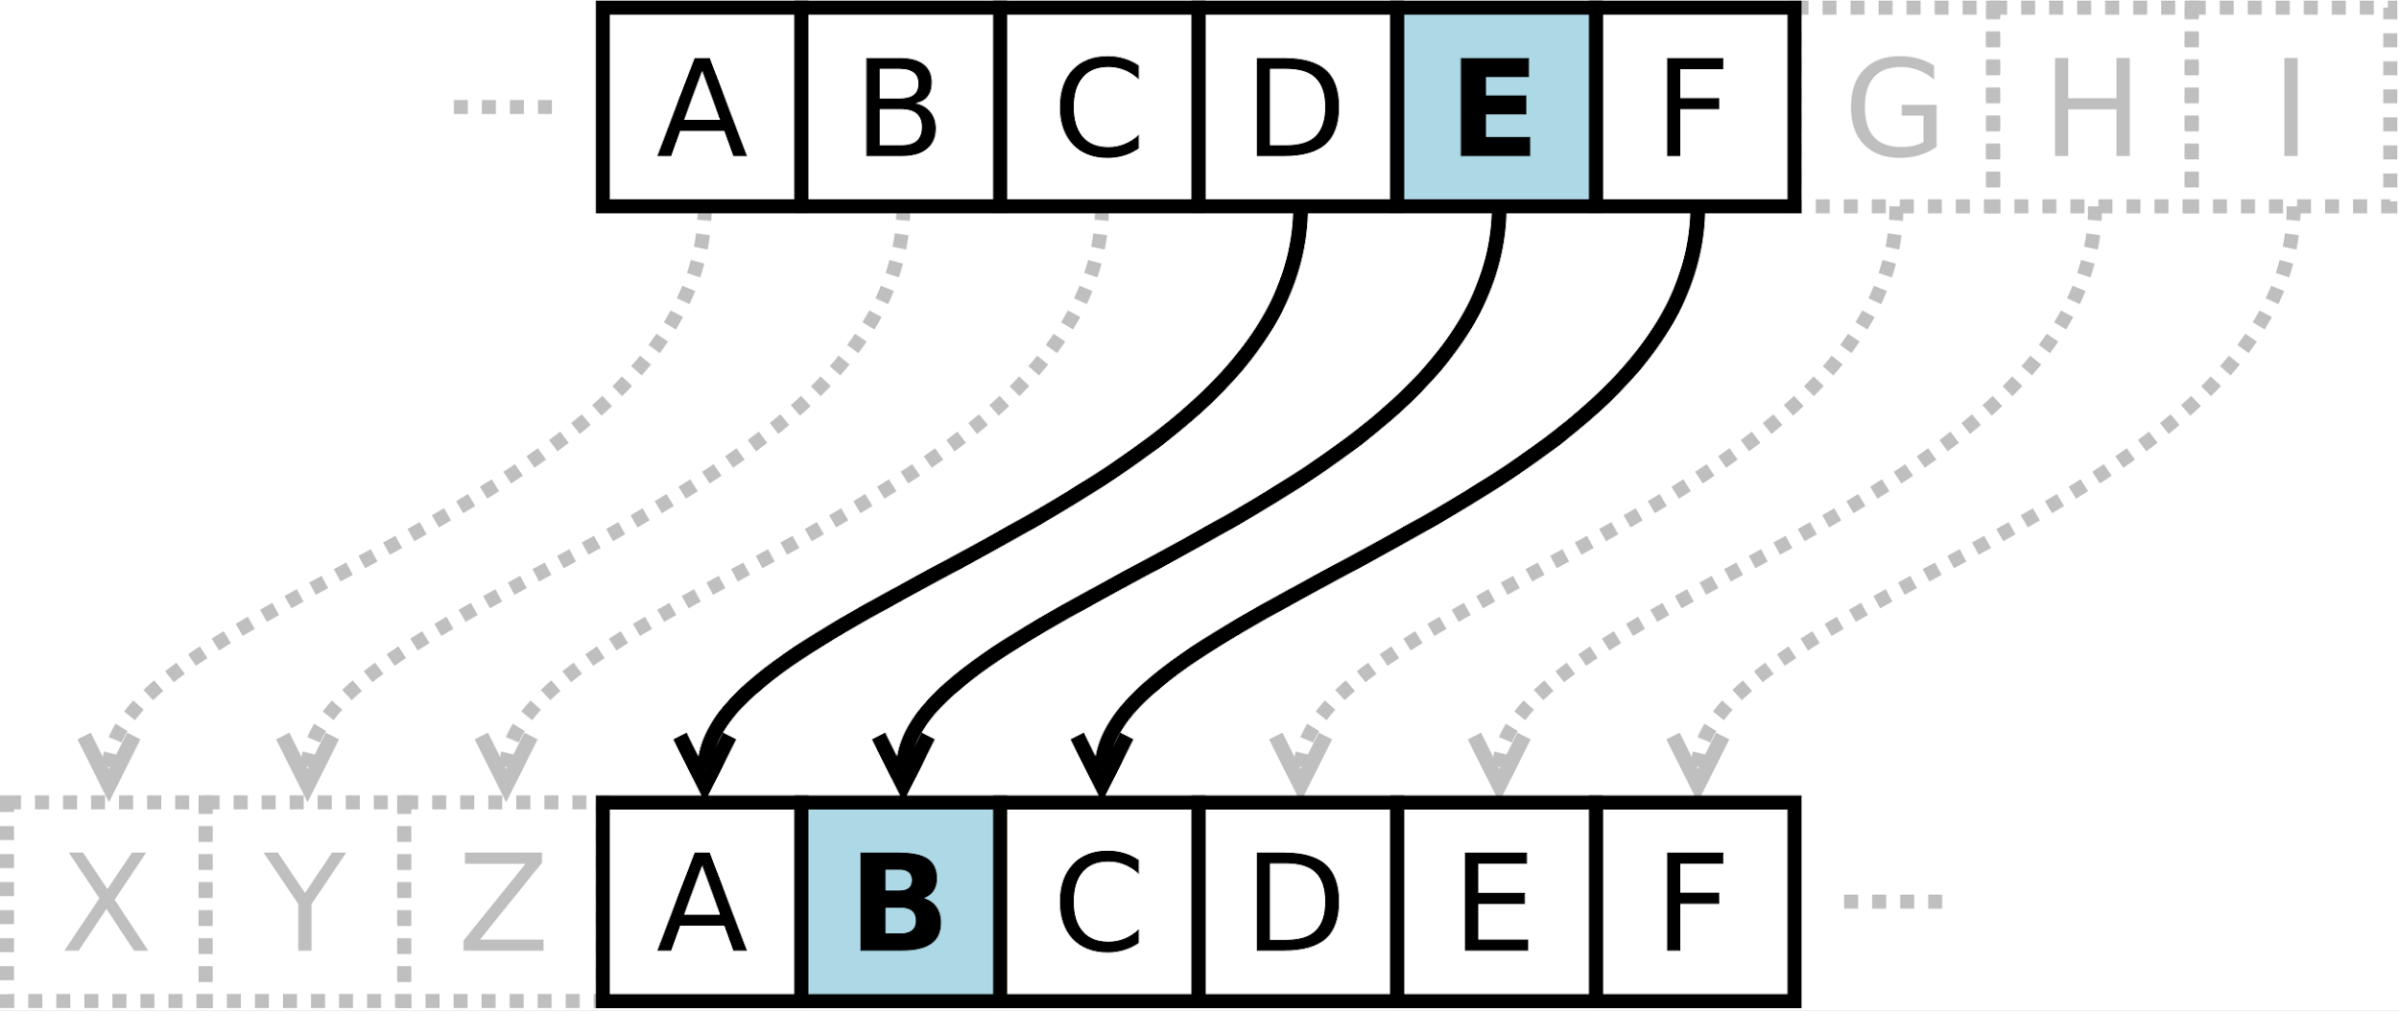
When did encryption become a thing❓
1900 B.C. -> 700 B.C. -> The Middle Ages -> 1976
700 B.C. - Caesar Shift Cipher
HELLO WORLD -> EBIIL TLOIA
Notes:
Break into 3 slides

Slide 7
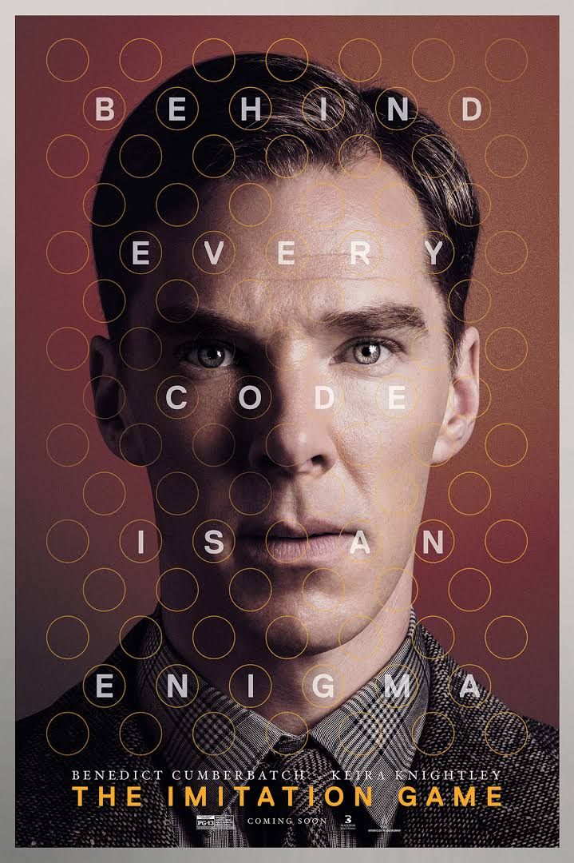
When did encryption become a thing❓
1900 B.C. -> 700 B.C. -> 1940s -> 1976
1940s - Enigma Machine & Turing Machine (The Imitation Game)
Notes:
Time problem

Slide 8
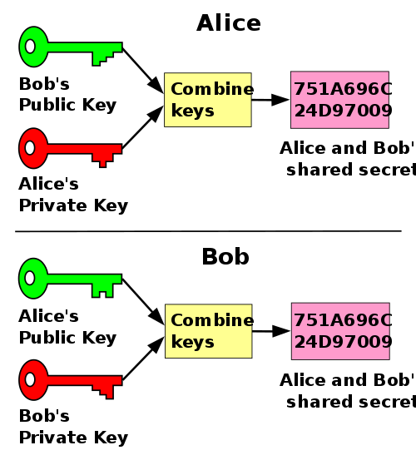
When did encryption become a thing❓
1900 B.C. -> 700 B.C. -> The Middle Ages -> 1976
1976 - “New Direction in Cryptography” by
Whitfield Diffie and Martin Hellman
Notes:
Break into 3 slides

Slide 9

Why do we need encryption anyway❓
Need privacy
What is the motivation behind it?

Slide 10
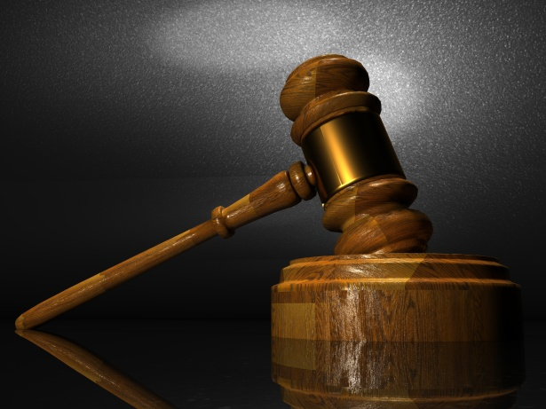
Why do we need encryption anyway❓
Laws
the Payment Card Industry Data Security Standard (PCIDSS) requires merchants to encrypt customers’ payment card data
What is the motivation behind it?
Notes:
There could be many other motivations behind encryption as well.

Slide 11


Slide 12
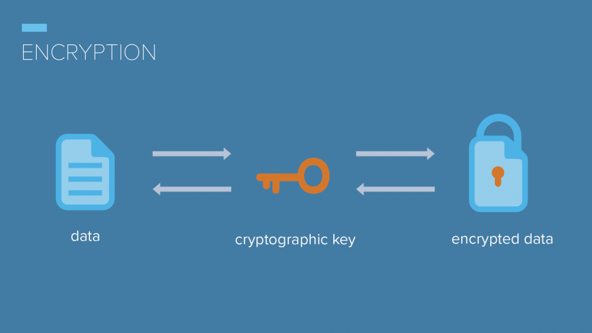
How does encryption work❓
Encryption uses algorithms to scramble the information in a way such that only certain people can read/understand it.
In other words, it requires ciphers to get the job done!

Slide 13
What are ciphers❓
An algorithm for performing encryption/decryption
A series of well-defined steps that can be followed as a procedure

Slide 14
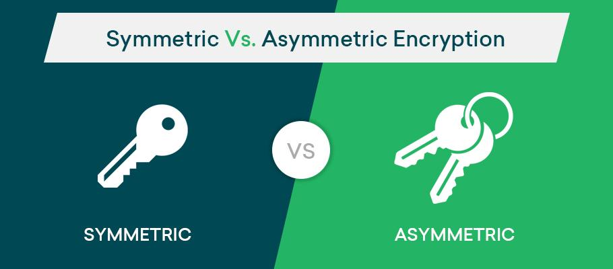
What are ciphers❓
Symmetric cipher
Same key for encryption/decryption
Asymmetric cipher
Different keys for encryption/decryption
What ciphers are mostly-used?
Notes:
Generally, there are two types of ciphers: symmetric and asymmetric

Slide 15
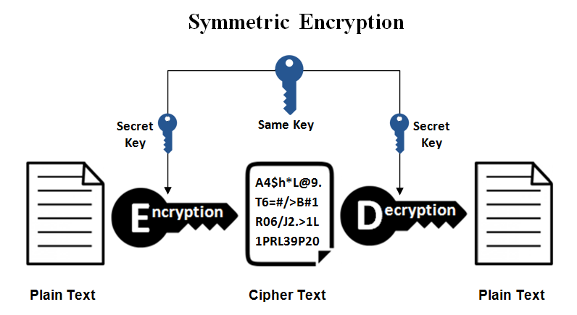
What are ciphers❓
Symmetric ciphers
AES (Advanced Encryption Standard)
https://www.youtube.com/watch?v=O4xNJsjtN6E&t=393s
What ciphers are mostly-used?
Notes:
First let’s take a look at symmetric ciphers:

Slide 16
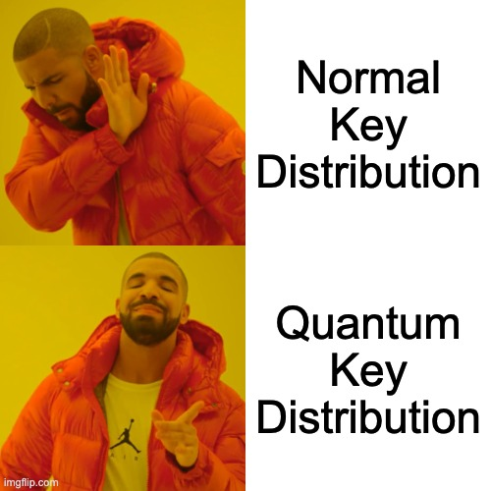
What are ciphers❓
Symmetric ciphers
Quantum key distribution (QKD)
What ciphers are mostly-used?

Slide 17
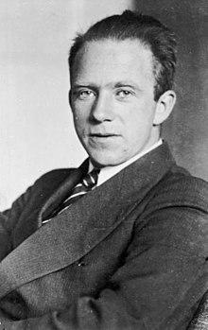

What are ciphers❓
Quantum key distribution (QKD)
relies on quantum mechanics
Traditional Public-Key Cryptography
relies on computational difficulty on certain mathematical functions
i.e. factorize a large integer
What ciphers are mostly-used?

Slide 18
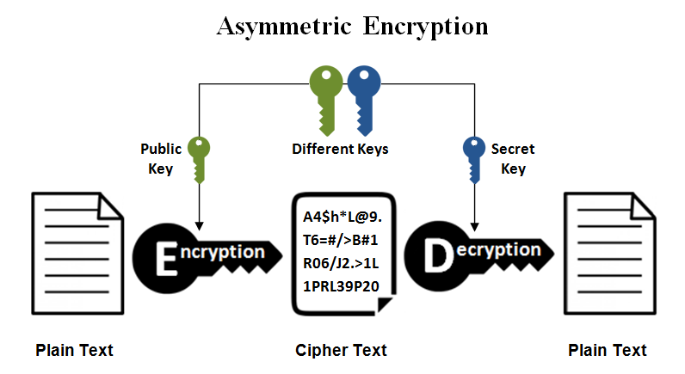
What are ciphers❓
Asymmetric cipher
RSA (Rivest-Shamir-Adleman)
What ciphers are mostly-used?

Slide 19
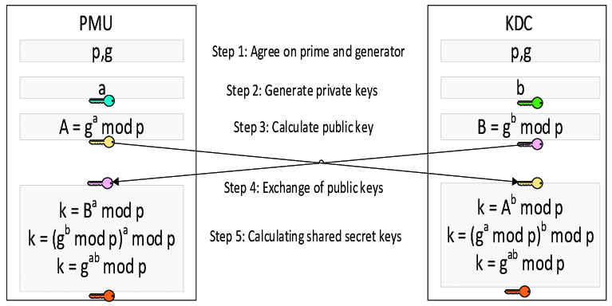
What are ciphers❓
Asymmetric cipher
Diffie-Hellman key exchange
What ciphers are mostly-used?
Notes:
Break it down
Provide with examples

Slide 20
Diffie-Hellman Key Exchange Example
p = 23, g = 9
Alice: a = 4 Bob: b = 3
Alice: A = gª mod p = 9⁴ mod 23 = 6
Bob: B = g^{b} mod p = 9³ mod 23 = 16
Alice: k = Bª mod p = 16⁴ mod 23 = 9
Bob: k = A^{b} mod p = 6³ mod 23 = 9

Slide 21
What are ciphers❓
Asymmetric cipher
Elliptic curve cryptography (ECC)
a.k.a. “better” RSA
Wait, what is a elliptic curve?
What ciphers are mostly-used?

Slide 22


Slide 23

What are ciphers❓
In mathematics elliptic curves are plane algebraic curves, consisting of all points {x, y}, described by the equation:
What ciphers are mostly-used?
Notes:
Avoid blah blah

Slide 24
What are ciphers❓
Cryptography uses elliptic curves in a simplified form (Weierstrass form), which is defined as:
y² = x³ + ax + b
where a, b are parameters
What ciphers are mostly-used?

Slide 25
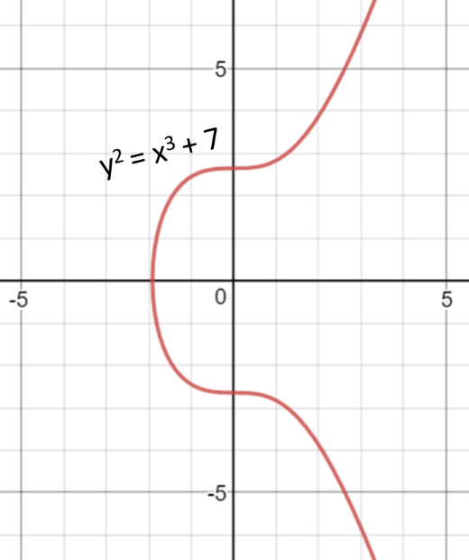
What are ciphers❓
The famous NIST curve secp256k1 (used in Bitcoin) is based on the elliptic curve with a = 0, b = 7
What ciphers are mostly-used?
Note: Different curves provide different level of security, different performance, and different key length

Slide 26
What are ciphers❓
Elliptic Curve Cryptography (ECC)
uses elliptic curves over the finite field
the field is a square matrix of p ✕ p
p is prime and p > 3
points are integer coordinates {x,y}
What ciphers are mostly-used?

Slide 27
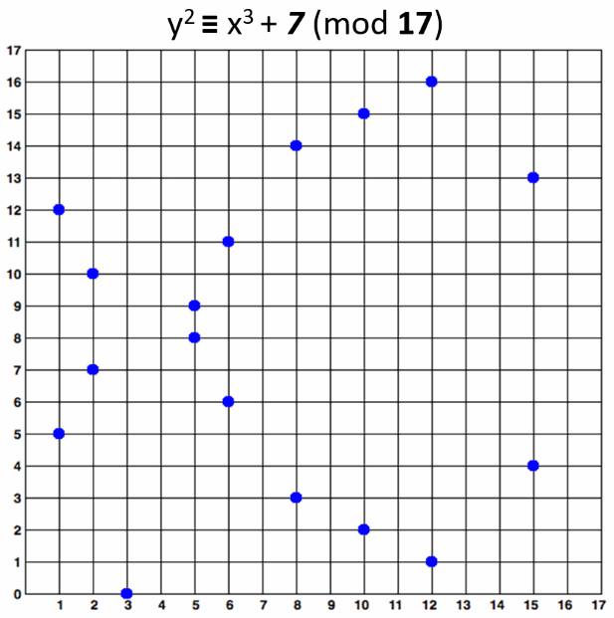
What are ciphers❓
Elliptic Curve Cryptography (ECC)
uses elliptic curves over the finite field
the field is a square matrix of p ✕ p
p is prime and p > 3
points are integer coordinates {x,y}
⇒ 0 ≤ x, y < p
e.g. the Bitcoin curve
What ciphers are mostly-used?
Notes:
A little more details about the EC points

Slide 28
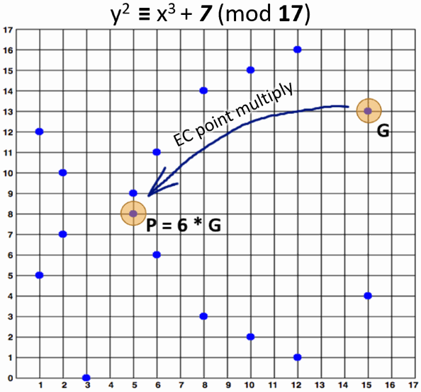
Elliptic Curve Cryptography
Two EC points can be added and result in another point. a.k.a. EC point addition
G: the generator point
k: an integer (private key)
P: obtained EC point (public key)
P = k * G
e.g.
G = {15, 13}, k = 6
P = k * G = 6 * {15, 13} = {5, 8}

Slide 29

Elliptic Curve Discrete Logarithm Problem
By given elliptic curve over finite field 𝔽p and generator point G on the curve and point P on the curve, find the integer k (if it exists), such that P = k * G
Recall:
P: public key
k: private key

Slide 30

What are ciphers❓
Elliptic Curve Cryptography (ECC)
private keys are integers in the range of the curve’s field size (normally 256-bit)
e.g. hex encoded, 32 bytes, 64 hex digits
Don’t panic, it’s as simple as securely generating a random integer in certain range (i.e. very fast)
0x51897b64e85c3f714bba707e867914295a1377a7463a9dae8ea6a8b914246319
What ciphers are mostly-used?

Slide 31
What are ciphers❓
Elliptic Curve Cryptography (ECC)
public keys are EC points (i.e. pairs of integer coordinates on the curve)
EC points can be compressed to just one coordinate + 1 bit (odd or even)
e.g. encode the y coordinate as prefix 02 or 03
0x02f54ba86dc1ccb5bed0224d23f01ed87e4a443c47fc690d7797a13d41d2340e1a
What ciphers are mostly-used?

Slide 32
What are ciphers❓
Elliptic Curve Cryptography (ECC)
because it uses smaller keys than RSA for the same level of security
fast key generation!
fast key agreement!
What ciphers are mostly-used?

Slide 33
50%
Recap:
Introduction to Encryption 👀
History of Encryption 📑
How does Encryption work 😲
Examples of Encryption 🐾
You have made it halfway!
We have covered
Advanced Encryption Standard (AES)
Quantum Key Distribution (QKD)
Rivest-Shamir-Adleman (RSA)
Diffie-Hellman Key Exchange
Elliptic Curve Cryptography (ECC)

Slide 34


Slide 35

Why homomorphic encryption❓
Sensitive data (like medical data) needs computation/analysis
↓
They cannot give be given to the third party for calculation directly
↓
Homomorphic encryption can help!

Slide 36

What is Homomorphic Encryption❓
A form of encryption that permits users to perform computations on its encrypted data without first decrypting it
Notes:
Have extra slide about Gentry
Need to break it down

Slide 37
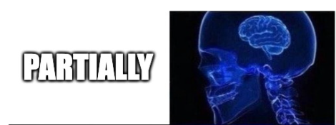
Homomorphic Encryption
Partially homomorphic encryption
either additively homomorphic or multiplicatively homomorphic
Notes:
Have extra slide about Gentry
Need to break it down

Slide 38
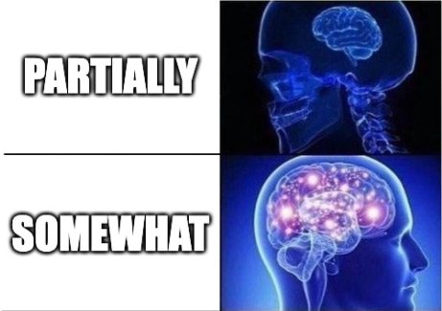
Homomorphic Encryption
Somewhat homomorphic encryption
capable of doing both addition and multiplication to the original plaintexts but its capability is heavily limited
Notes:
Have extra slide about Gentry
Need to break it down

Slide 39
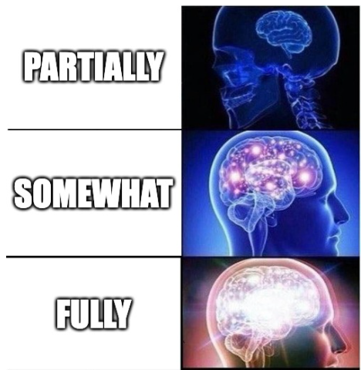
Homomorphic Encryption
Fully homomorphic encryption
can do arbitrary computation to the plaintexts by manipulating the ciphertexts
Notes:
Have extra slide about Gentry
Need to break it down

Slide 40
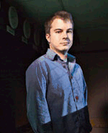
Fully Homomorphic Encryption
Doctor Craig Gentry
constructed the first Fully Homomorphic Encryption scheme
Introduced bootstrapping
Notes:
Have extra slide about Gentry
Need to break it down

Slide 41
Homomorphic encryption
Original
data
Computation
result
=
=
=
Original
data
Encryption
Encrypted
data
Computation
Encrypted result
Decryption
Decrypted
result
Notes:
Build off from the

Slide 42
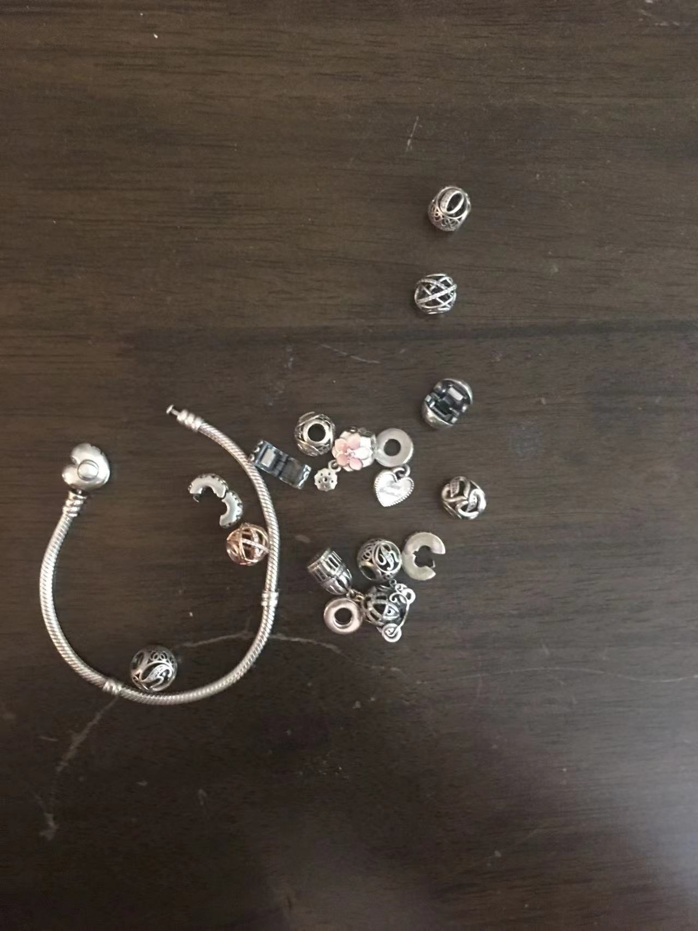
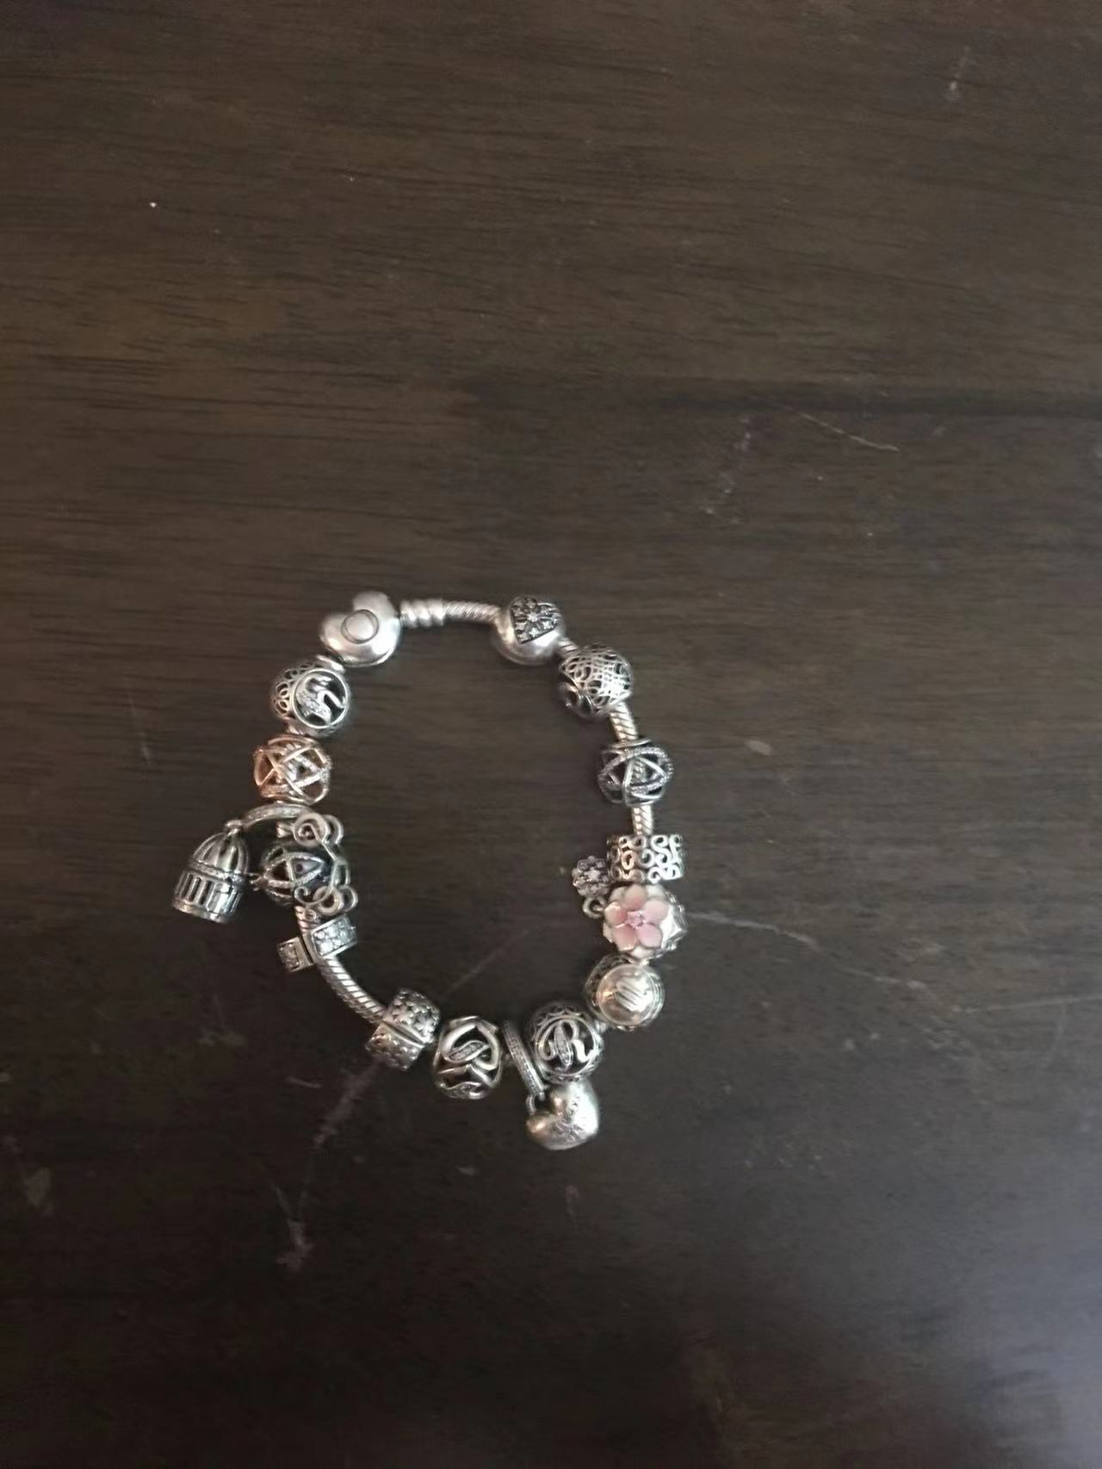
Alice’s Jewelry store
original
Finished item

Slide 43
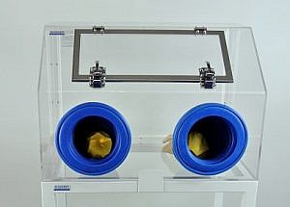
Alice and gloveboxes
worker
Alice

Slide 44
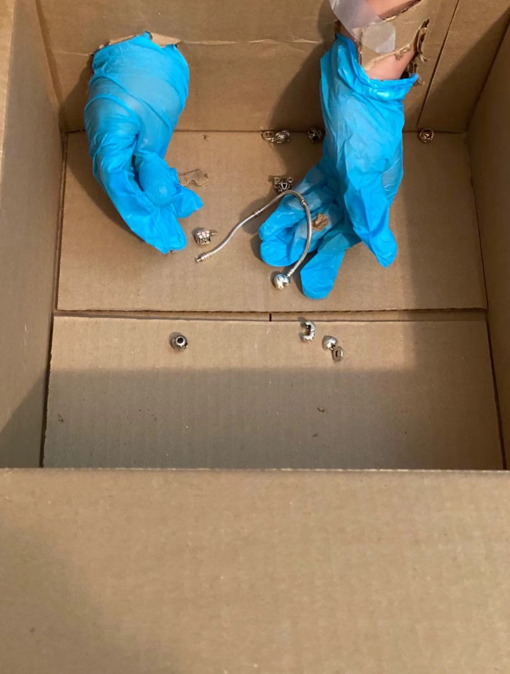
The glove box
=
Worker is working on it.

Slide 45

Defective gloves
Need to change every 5 min

Slide 46
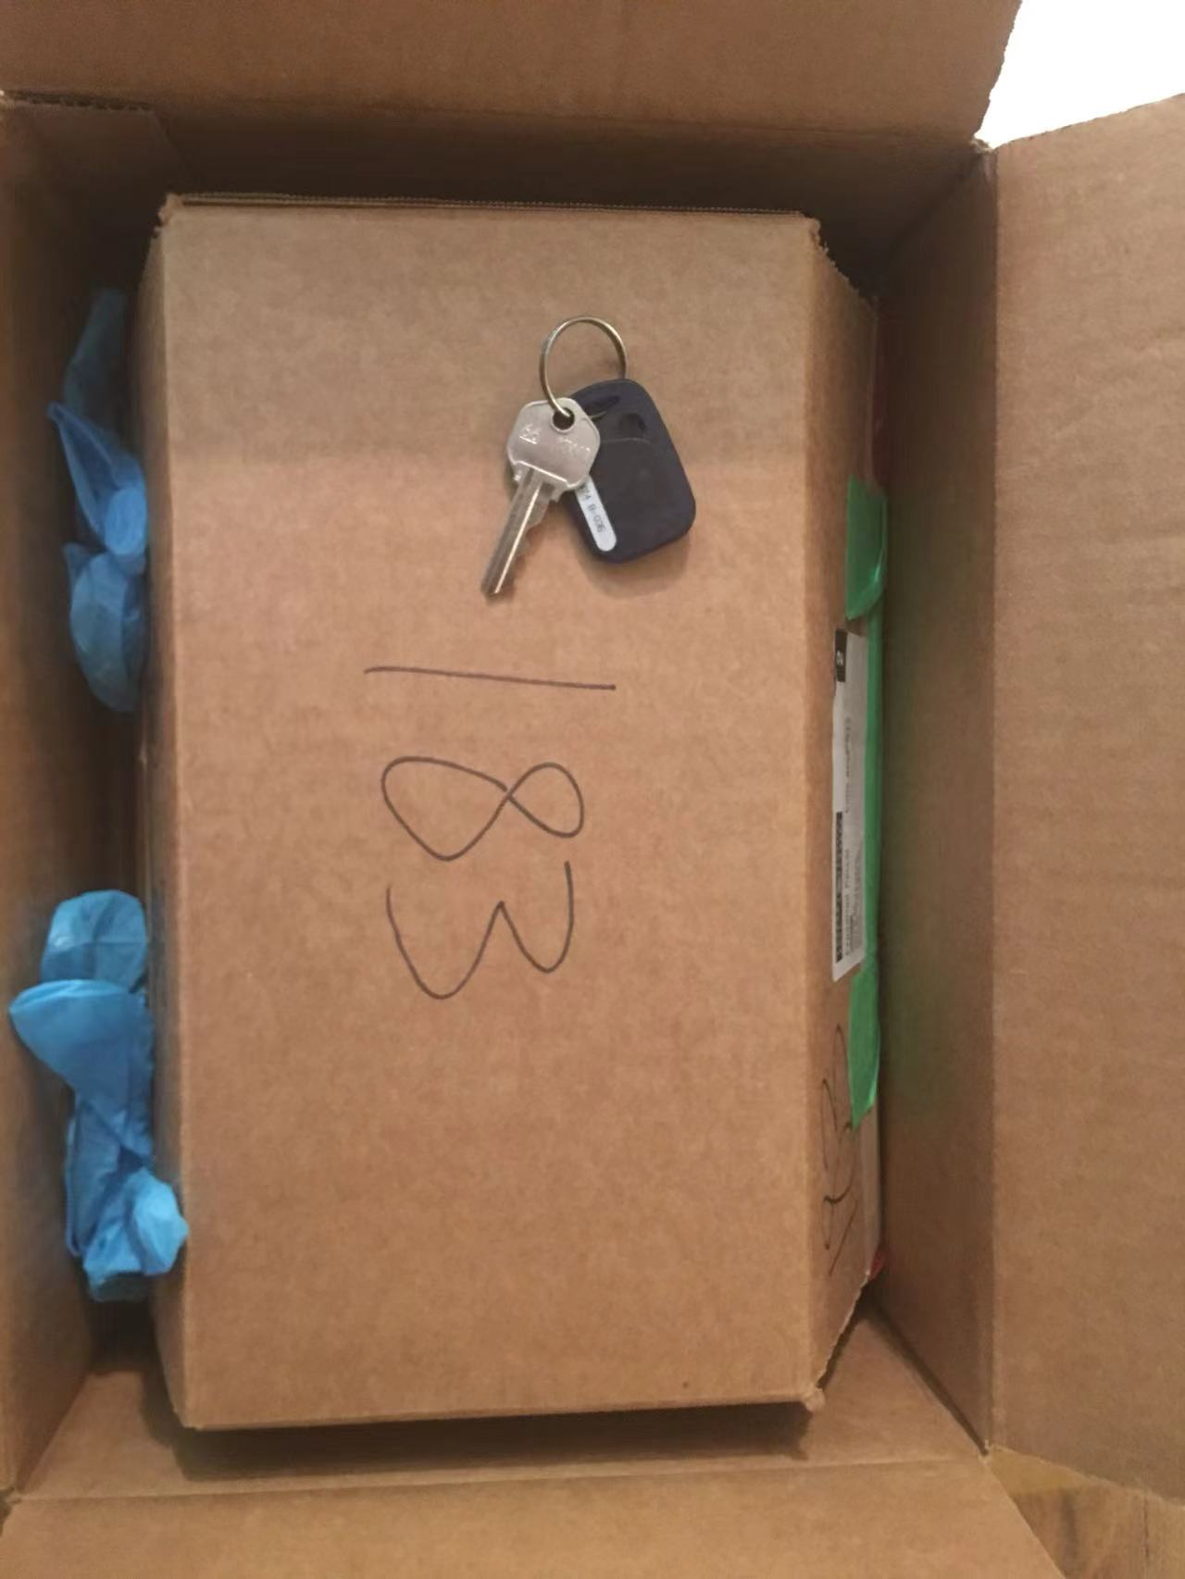
Put the previous box and its key into another box
Box 1’s key
Box 2
In box 2, there is box 1 and box 1’s key. Therefore, the worker can open box 1 inside box 2, but cannot get the jewelry out of box 2. Because Alice has box 2’s key.
Box 1
Notes:
Horrible gloves which cannot last long enough for completing assembling.
Method that the worker cannot take the box 1 out

Slide 47
Last step
Alice opens the last box with the last key and gets her jewelry!
Second last box’s key
Last box
Second last box
Only she can take the jewelry out because she’s smart and always keeps the outer boxes key!

Slide 48
Original
data
Computation
result
=
=
=
Original
data
Encryption
Encrypted
data
Computation
Encrypted result
Decryption
Decrypted
result
So when we look back to homomorphic encryption…

Slide 49
Four Algorithms in Homomorphic
Encryption
KeyGen
Encrypt
Evaluate
Decrypt

Slide 50
How do the four algorithms work in HE
Let’s describe it as symmetric encryption scheme which is easier to understand.
Also, both plaintext and ciphertext here is binary.
And say we want to do this with 1100.
Notes:
Hard to follow

Slide 51
AGAIN

Slide 52
How do the four algorithms work in HE
λ: security parameter (set by the user)
a,b: randomly generated by the algorithm
For the purpose of demonstration, we set λ = 2, a = 2, and b = 5
N = λ = 2
P = λª = 2² = 4
Q = λ^{b} = 2⁵ = 32
Notes:
Hard to follow

Slide 53
How do the four algorithms work in HE
p ∈ [1, λ^{P}-1] ⇒ p ∈ [1, 2⁴-1] ⇒ p ∈ [1, 15]
p % 2 == 1 ⇒ p is odd
q ∈ [0, λ^{Q}-1] ⇒ q ∈ [0, 2³² -1] ⇒ q ∈ [0, 4294967295]
q could be different for each bit of the plaintext

Slide 54
How do the four algorithms work in HE
p | 7 | 7 | 7 | 7
plaintext | 1 | 1 | 0 | 0
q | 13 | 2526 | 2022 | 26
ciphertext | 92
ciphertext = plaintext + p * q
92 = 1 + 7 * 13
Notes:
Go slower

Slide 55
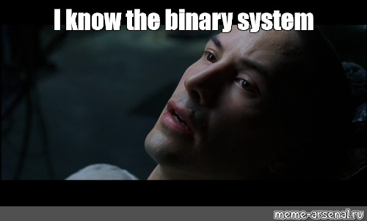
How do the four algorithms work in HE
Now let’s convert 92 back to binary!
ciphertext[0] = 1011100
It needs to be N + Q = 2 + 32 = 34 bits long (i.e. padding)
Therefore ciphertext[0] = 0000000000000000000000000001011100

Slide 56
How do the four algorithms work in HE
Evaluate
Computations
For FHE, it should include everything
For partially and somewhat, they cannot.

Slide 57

How do the four algorithms work in HE
ciphertext[0] = 0000000000000000000000000001011100 = 92
Now let’s decrypt it!
plaintext[0] = (ciphertext[0] mod p) mod 2 = (92 mod 7) mod 2 = 1 mod 2 = 1
However, the operations(evaluate part) increase the noise associated to resulting ciphertexts.
Therefore, after several operations, the noise could become large enough that decryption is no longer reliable.
Notes:
Explain more on the error part (with example)

Slide 58
Bootstrapping
reduce the error without decrypt in the middle
Only for fully homomorphic encryption

Slide 59
Bootstrapping
Encrypted message
Box 1
Box 2
Box 3
Third party:
message
Box 1 and box 1’s key
Box 2 and box 2’s key
Owner:
Box 1’s key
Box 2’s key
Box 3’s key
…
Box i
Eventually, only the owner can get the encrypted message out and decrypt it.
…
Box i-1 and box i-1’s key
…
Box i’s key
Note: Box 1 + Box 1’s key => Message in Box 2

Slide 60
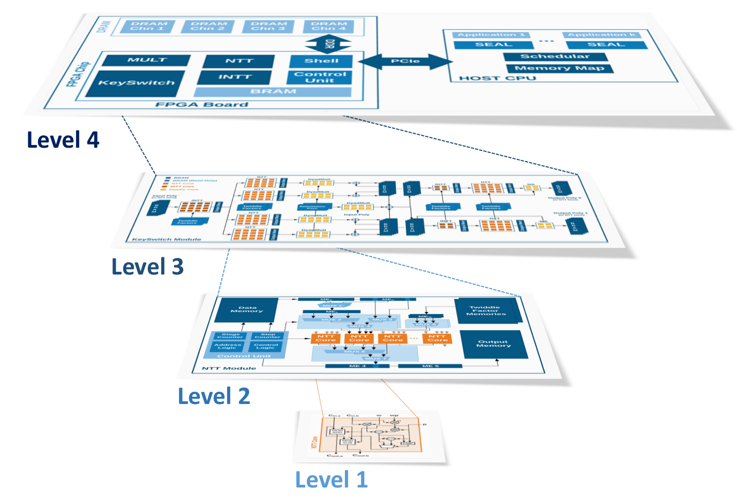
Future directions
Microsoft’s project Heax
Cloud computing and storage!
Designing a new computing architecture, specifically designed for FHE.

Slide 61
References
https://blog.openmined.org/from-fully-homomorphic-encryption-to-silicon/
https://en.wikipedia.org/wiki/Encryption
https://www.techtarget.com/searchsecurity/definition/encryption
https://medium.com/searchencrypt/what-is-encryption-how-does-it-work-e8f20e340537
http://blog.higashi.tech/2020/06/22/fhe_02.html
https://www.cleatech.com/product-category/glove-box-system/portable-glove-boxes/
https://crypto.stanford.edu/craig/craig-thesis.pdf
https://crypto.stanford.edu/craig/easy-fhe.pdf
https://www.geeksforgeeks.org/rsa-algorithm-cryptography/
https://cryptobook.nakov.com/asymmetric-key-ciphers/elliptic-curve-cryptography-ecc
http://blog.higashi.tech/2020/06/16/fhe_01.html
https://en.wikipedia.org/wiki/Homomorphic_encryption
https://www.geeksforgeeks.org/implementation-diffie-hellman-algorithm/

Slide 62
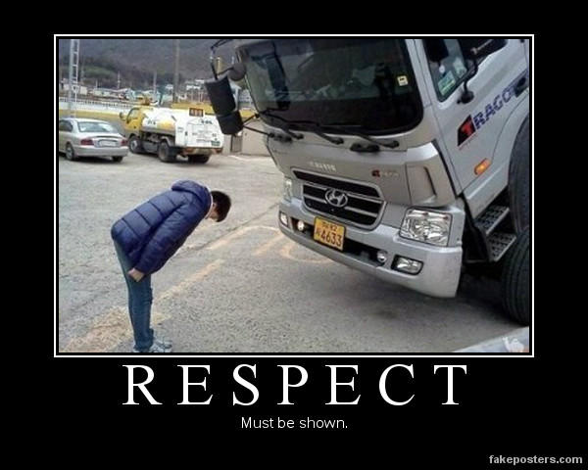
References
Shout out to whoever made those memes, you have my 100% respect

Slide 63

Thank You!
Notes:
Recent Work
Future direction of H.E.

